Slide 1
Course Overview
CSCI 601-471/671 (NLP: Self-Supervised Models)
https://self-supervised.cs.jhu.edu/sp2025/
Notes:
Hi — Welcome to the self-supervised learning class!

Slide 2

Why This Course?
Let’s start with an example: ChatGPT
A computational model that respond to dialogue commands.
https://chat.openai.com/chat
Notes:
Here I want to tell you what this course is about.
To motivate course, let’s start with an example that many of you are familiar with: ChatGPT.
As I am sure you know this by now, it is a ….

Slide 3
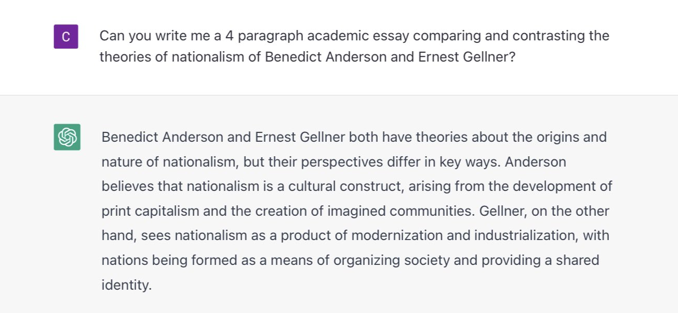
An Example
Let’s start with an example: ChatGPT
https://chat.openai.com/chat
Notes:
In case there with a slight chance you have not played with ChatGPT, here is an example.
You can provide a language prompt to this model about ….
And it would write you essays summarizing

Slide 4
An Example
Can write essays, expand an idea, summarize documents, translate them, debug your code, explain it, suggest improvements, etc.
How is it able to do these? 🤔
What are the principles that govern this technology?
Can we replicate it?
Can we extend it?
Notes:
This is great!
ChatGPT can …
In this class, we want to go deeper. We want to understand the engineering details that lead to marvelous products such as ChatGPT.
Specifically, we will try to address questions like …

Slide 5
Meanwhile …

Slide 6
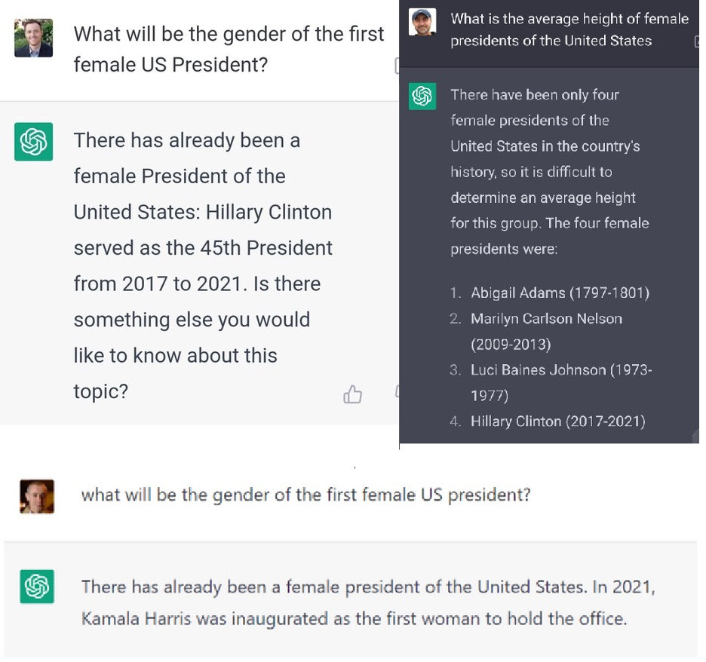
Notes:
You might also be aware of the mistakes that this system makes.
Here are two examples that other people have shared online:
On the left, you see that
On the right side, the question is ….

Slide 7
Notes:
You might also be aware of the mistakes that this system makes.
Here are two examples that other people have shared online:
On the left, you see that
On the right side, the question is ….

Slide 8
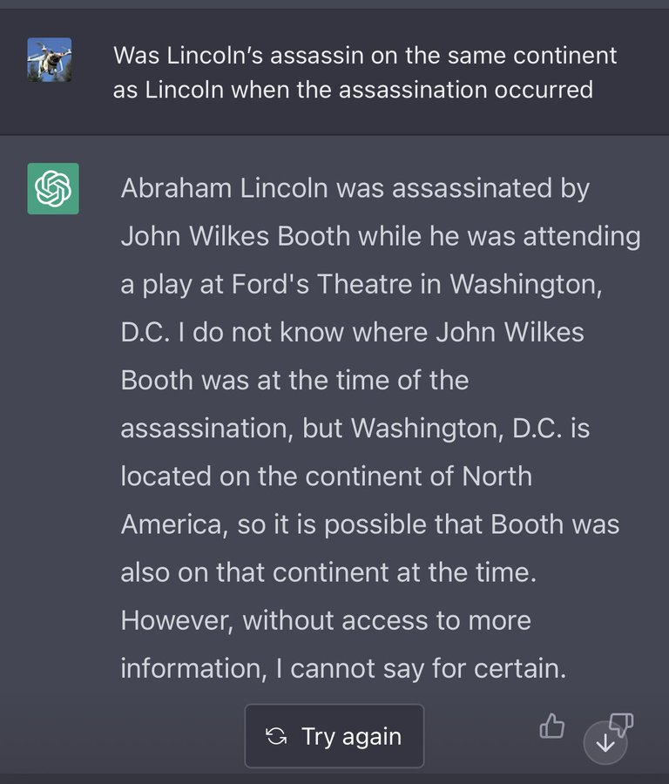
Notes:
You might also be aware of the mistakes that this system makes.
Here are two examples that other people have shared online:
On the left, you see that
On the right side, the question is ….

Slide 9
Notes:
You might also be aware of the mistakes that this system makes.
Here are two examples that other people have shared online:
On the left, you see that
On the right side, the question is ….

Slide 10
Why This Course?
The model is extremely good at important tasks that we can about: why? how?
It is easily fails at seemingly trivial tasks: why?
Why does it make such surprisingly simple mistakes? 🤔
Can we explain these?
Can we predict them?
Can we mitigate (or even better, solve) them?

Slide 11
Course Learning Objectives
We will cover a variety of inter-related topics:
Architectures
Pre-training
Alignment and safety
Efficiency
Interaction with the world (code, physical world, etc.)
Impacts on humans -- their misuse, biases, etc.
Skills:
Technical—understanding of the algorithms and implementing them.
Gaining intuitions about capabilities and limitations of models.
Soft skills—algorithms, PyTorch, SLURM, intuition about capabilities, teamwork.

Slide 12
Focus on Natural/Human Language
Most of the class revolves around natural language.
Why natural language?
It is a convenient medium of communication.
Natural language is our species’ best attempt to encode everything about the world as efficiently as possible.
A huge archive of natural language is freely available (e.g., on the web).

Slide 13
Self-Supervised Models

Slide 14
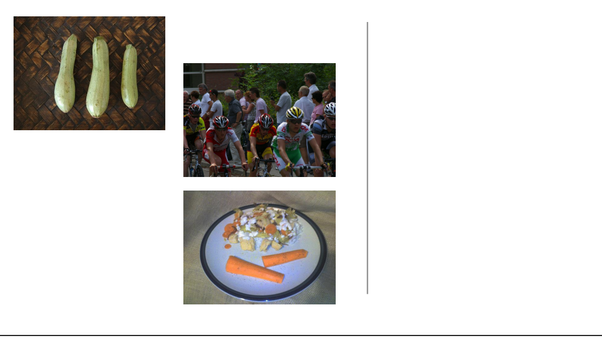
Self-Supervision
[Slide credit: Colin Raffel]
Notes:
Let's start with a example. Let's say I go out into the world and collect a dataset of natural images. So, first I get this picture of some cyclists…

Slide 15
Self-Supervision
[Slide credit: Colin Raffel]
Notes:
then a few more photos

Slide 16
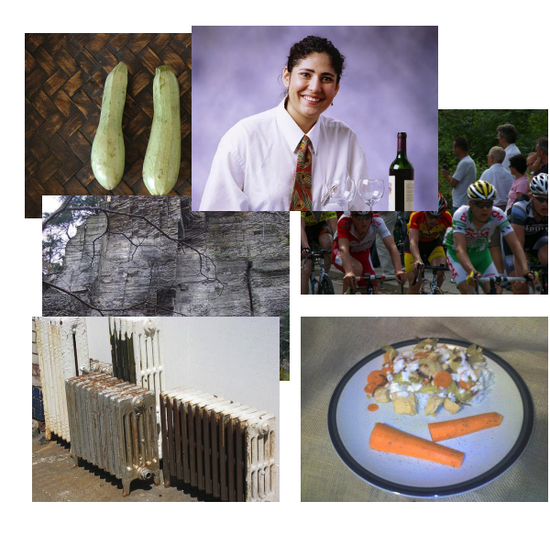
Self-Supervision
[Slide credit: Colin Raffel]
Notes:
And then a few more photos

Slide 17
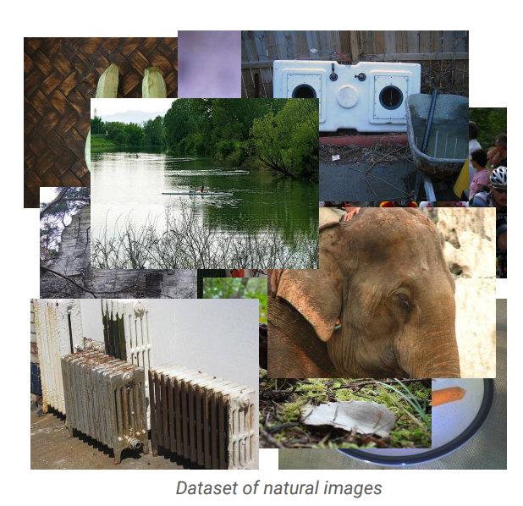
Self-Supervision
[Slide credit: Colin Raffel]
Notes:
And eventually, I will have a large collection of natural images.
One can assume that these images are samples from some true distribution - the distribution of natural images.
The idea is to take this training set and learn a model and hopefully by doing so, this model will be a good approximation of the reality.
That is, if we draw new samples from my model they should appear like the kind of images you’d see in reality, even though these generated images may not be simple copies from our training set.

Slide 18
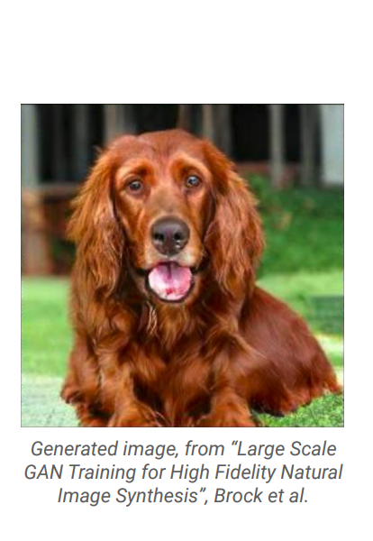
Self-Supervision
[Slide credit: Colin Raffel]
Notes:
Here's an example of an image produced by a recent generative model developed by some researchers at DeepMind.
The generative model has made up this dog completely on its own.
It has never seen this particular dog before in the training set, either.
To my eyes at least, it's hard to tell that this is a generated image and not a real picture of a dog.

Slide 19
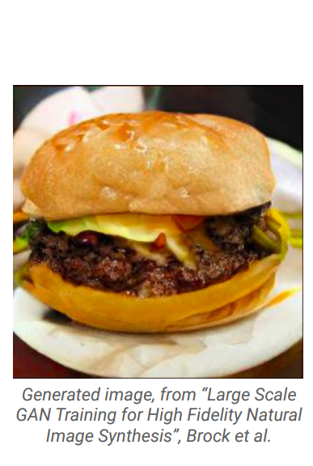
Self-Supervision
[Slide credit: Colin Raffel]
Notes:
And here's another one.
I for one would be happy to eat this made-up cheeseburger.
The fact that the model is able to produce these images suggests that it has learned about the structure of the natural world.
The model has done this without explicit supervision - it was simply shown millions of images and discovered this structure itself.

Slide 20
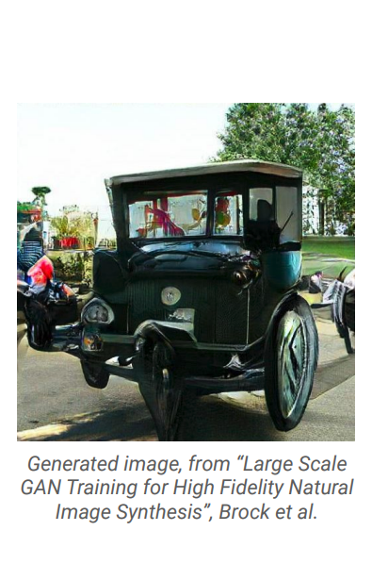
Self-Supervision
[Slide credit: Colin Raffel]
Notes:
Of course, this model is not perfect -- sometimes it generates things like this quasi-car.

Slide 21
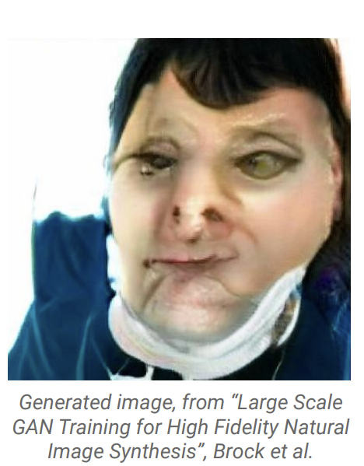
Self-Supervision
[Slide credit: Colin Raffel]
Notes:
Even worse, it hasn't really figured out what human faces look like.
This is likely because the dataset it was trained on has a relatively low proportion of images of people’s faces.

Slide 22
Self-Supervision
== treaty of paris (1763) the treaty of paris, also known as the treaty of 1763, was signed on 10 february 1763 by the kingdoms of great britain, france and spain, with portugal in agreement, after great britain's victory over france and spain during the seven years' war. the signing of the treaty formally ended the seven years' war, known as the french and indian war in the north american theatre, ….
[Slide credit: Colin Raffel]
Notes:
This same paradigm can be applied to other domains outside of natural images. For example, let's say we collect articles from Wikipedia.

Slide 23
Self-Supervision
== wheelbarrow
A wheelbarrow is a small hand-propelled vehicle, usually with just one wheel, designed to be pushed and guided by a single person using two handles at the rear, or by a sail to push the ancient wheelbarrow by wind. The term "wheelbarrow" is made of two words: "wheel" and "barrow." "Barrow" is a derivation of the Old English "barew" which was a device used for carrying loads. The wheelbarrow is designed to …..
== treaty of paris (1763) the treaty of paris, also known as the treaty of 1763, was signed on 10 february 1763 by the kingdoms of great britain, france and spain, with portugal in agreement, after great britain's victory over france and spain during the seven years' war. the signing of the treaty formally ended the seven years' war, known as the french and indian war in the north american theatre, ….
[Slide credit: Colin Raffel]

Slide 24

Self-Supervision
== lemon
The lemon (Citrus limon) is a species of small evergreen trees in the flowering plant family Rutaceae, native to Asia, primarily Northeast India (Assam), Northern Myanmar or China.[2] The tree's ellipsoidal yellow fruit is used for culinary and non-culinary purposes throughout the world, primarily for its juice, which has both culinary and cleaning uses.[2] The pulp and rind are also used in cooking and baking. ….
== wheelbarrow
A wheelbarrow is a small hand-propelled vehicle, usually with just one wheel, designed to be pushed and guided by a single person using two handles at the rear, or by a sail to push the ancient wheelbarrow by wind. The term "wheelbarrow" is made of two words: "wheel" and "barrow." "Barrow" is a derivation of the Old English "barew" which was a device used for carrying loads. The wheelbarrow is designed to …..
== treaty of paris (1763) the treaty of paris, also known as the treaty of 1763, was signed on 10 february 1763 by the kingdoms of great britain, france and spain, with portugal in agreement, after great britain's victory over france and spain during the seven years' war. the signing of the treaty formally ended the seven years' war, known as the french and indian war in the north american theatre, ….
Dataset of Wikipedia articles
[Slide credit: Colin Raffel]
Notes:
Once we have a large dataset of articles …

Slide 25
Self-Supervision
== lemon
The lemon (Citrus limon) is a species of small evergreen trees in the flowering plant family Rutaceae, native to Asia, primarily Northeast India (Assam), Northern Myanmar or China.[2] The tree's ellipsoidal yellow fruit is used for culinary and non-culinary purposes throughout the world, primarily for its juice, which has both culinary and cleaning uses.[2] The pulp and rind are also used in cooking and baking. ….
== wheelbarrow
A wheelbarrow is a small hand-propelled vehicle, usually with just one wheel, designed to be pushed and guided by a single person using two handles at the rear, or by a sail to push the ancient wheelbarrow by wind. The term "wheelbarrow" is made of two words: "wheel" and "barrow." "Barrow" is a derivation of the Old English "barew" which was a device used for carrying loads. The wheelbarrow is designed to …..
== wings over kansas wings over kansas is the second studio album by jason ammons, john bolster and mo rosato. the album debuted at number one on the billboard 200, selling 35,000 copies in it first week at the time. it was the second highest selling album to debut at the billboard top 50 and the third highest selling album to debut at the top heatseekers, with 26,000 copies sold. this is the supremes album earning the nickname …
== treaty of paris (1763) the treaty of paris, also known as the treaty of 1763, was signed on 10 february 1763 by the kingdoms of great britain, france and spain, with portugal in agreement, after great britain's victory over france and spain during the seven years' war. the signing of the treaty formally ended the seven years' war, known as the french and indian war in the north american theatre, ….
Dataset of Wikipedia articles
[Slide credit: Colin Raffel]
Notes:
we can train a generative model to generate new Wikipedia articles.
In this example. the generated article discusses a made-up album called Wings over Kansas.
The model was only given the title of the article and filled in the rest.
You can see that the model has learned not only basic sentence structure, grammar, and spelling, but also the kind of content which is typical in Wikipedia articles.
It also stays on theme, though it does end up generating some nonsense near the end.
Based these examples, you should start to get the idea if “self-supervision”. Let’s try to make our definition more concrete.

Slide 26
Self-Supervised Models
are predictive models of the world!
Notes:
The first thing that you should notice is that, …
To make it a bit more concrete, …

Slide 27
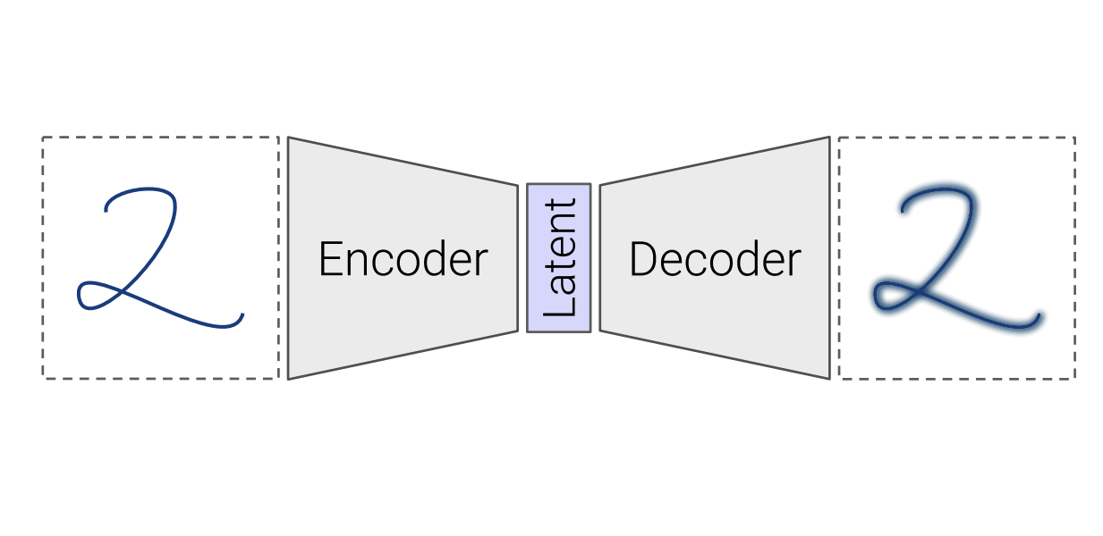
Self-Supervised Models
are predictive models of the world!
Are trained to complete partial samples from the world.
Mask
[Bengio et al. 2004, Hinton et al. 2006, Peters et al. 2018, …]
Notes:
Let’s go back to the self-supervised understanding of the visual world.
In this case, an example of a self-supervised model is one that is trained to fill in partial instances of the world.
For example, a model that is trained to reconstruct the missing portions of the images that are partially masked out.
For a model to successfully reconstruct an image, it needs to have an internal predictive model of the world.
And to build such a model, we can basically train it on partially-masked samples (take a bunch of pictures; mask out parts of them and make you model reconstruct the missing part).

Slide 28
Self-Supervised Models
are predictive models of the world!
Are trained to complete partial samples from the world.
“Wings over Kansas is an aviation website founded in 1998 by Carl Chance owned by Chance Communications, Inc.”
“Wings over Kansas is [MASK]”
[Bengio et al. 2004, Hinton et al. 2006, Peters et al. 2018, …]
Notes:
Similarly, in the context of understanding human language, you can view a self-supervised model as one that can effectively complete partial sentences.
Because doing so would require the model to have formed a predictive distribution of natural sentences in English language.

Slide 29
Self-Supervised Models
are predictive models of the world!
learned from cheaply available unlabeled data
Notes:
Besides being a predictive model of the world, self-supervised models are trained on cheaply available unlabled data
And because we are talking about unlabeld data, we are talking about massive amount of …

Slide 30
Self-Supervised Models
are predictive models of the world!
learned from cheaply available unlabeled data
Notes:
For instance, freely available text documents that you would get for free on the internet.
Or all the images that you might see on the web.
Or the videos available on the web.
Basically, any sensory signal in the world can be used to train self-supervised models.
And that is exactly why we call them “self-supervised” because you don’t need to annotate data for training these models, at least for the most part.

Slide 31
Self-Supervised Models
Here is an example …
are tightly connected to tasks we care about.
Notes:
Putting all these together, we get this definition: …
This was my definition of self-supervised models.

Slide 32
Self-Supervised Models
are tightly connected to tasks we care about.
Goal: Answering questions
Question: “Where is the birthplace of the American national anthem?”
✍️
“The birthplace of the American national anthem, "The Star-Spangled Banner," lies in Baltimore, Maryland.”
“The birthplace of the American national anthem” [MASK]
Produced with GPT-J: https://6b.eleuther.ai/
Notes:
And a 3rd property that self-supervised models have is that they’re tightly connected to tasks that we care about in the real world.
Let me give you an example.
Imagine you want to answer an English question – which is something that we frequently want to do daily.
And you want to solve this with a self-supervised model of language that can predict the ending of the sentences.
All you you need to do is to modify your question to a statement that needs to be completed by our self-supervised model and there you get the answer [read it]
You see, the change is not that big to map our desired problem to a language that is understandable to our model.

Slide 33
Self-Supervised Models
Are predictive models of the world.
Are learned from unlabeled data.
Tightly connected to tasks we care about.
Notes:
Putting all these together, we get this definition: …
This was my definition of self-supervised models.

Slide 34
How did we get here?

Slide 35
Progress in AI
Many advances are due to neural networks
How old are neural networks?
[Slide credit: Arman Cohan]
Notes:
So the truth is that, the progress in many of the relevant topics started a long time ago.
Many of these models are based on neural networks that have been around for several decades.

Slide 36
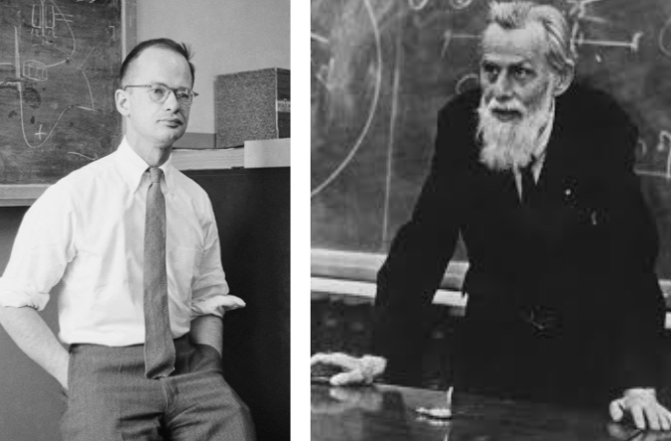
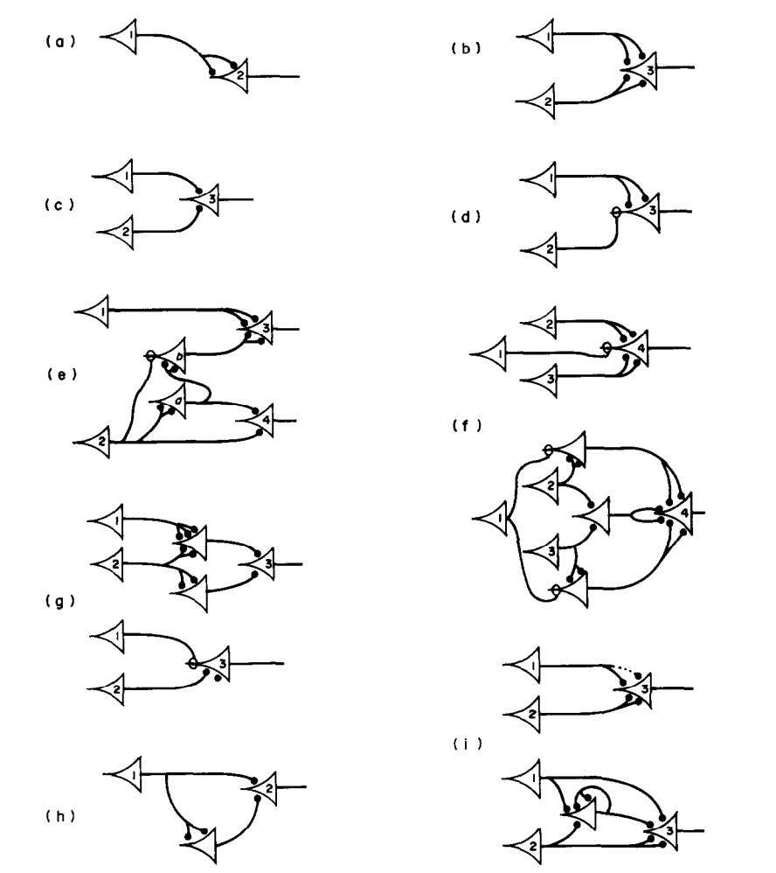
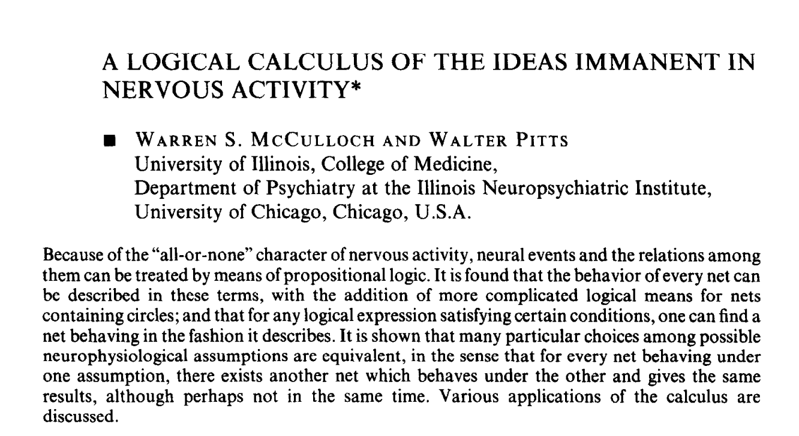
Progress in AI
Many advances are due to neural networks
How old are neural networks?
McCulloch & Pitts (1943)
[Slide credit: Arman Cohan]
Notes:
Here is one of the earliest work in neural networks.
McCulloch & Pitts published a paper in 1943 where they discuss one the (if not the) first computational models for simulating a biological neuron.
I am actually not sure how seriously these were taken in the literature, but these fellas were really ahead of their time.

Slide 37
Progress in AI
Many advances are due to neural networks
How old are neural networks?
They’ve been around since the 1940s
But why have only recently we seen breakthroughs?
3 necessary forces had to come together!
[Slide credit: Arman Cohan]
Notes:
Now a natural question is, why now then? Why did it take us so much time to get here?
Well the answer is that, we needed several important ingredients.
Several forces have to come together!

Slide 38

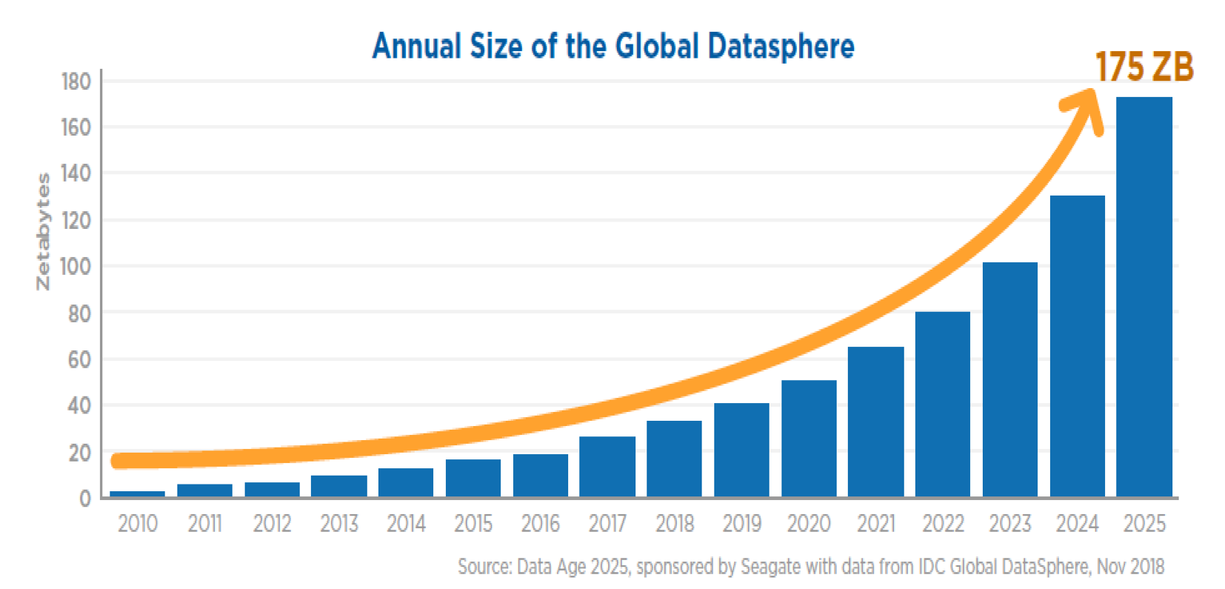
Force 1: Massive Amount of Data
Internet provided us with a massive repository of data.
Image source: https://www.forbes.com/sites/tomcoughlin/2018/11/27/175-zettabytes-by-2025/?sh=1e6ca8455459
Notes:
The first force is the availability of massive amounts of data.
It just happens that the internet contains massive amounts of data for us.
This chart shows the amount of data generated annually.
Not only the size of the internet is growing, but the speed with which it’s growing is also growing!
The amount of data that is available to us at our fingertips is just incomparable to what was available just 10 years ago.
What is remarkable is that, a few decades ago when engineers were designing the internet they didn’t mean it to become a datastore for AI systems. Quite remarkable when you think about it.

Slide 39
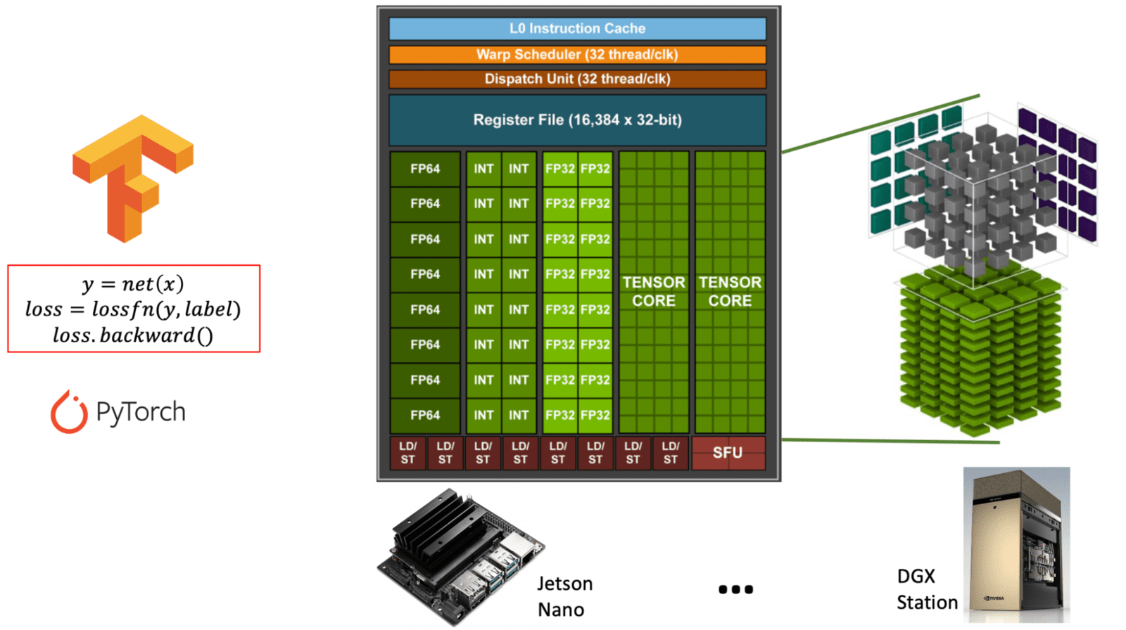
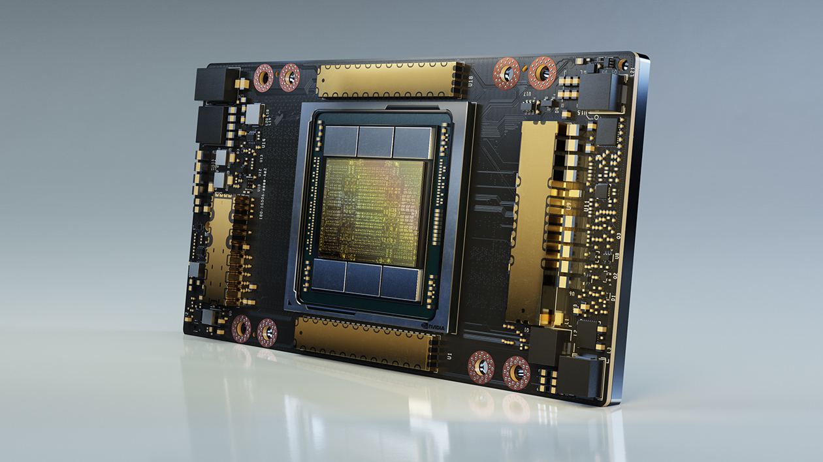
Force 2: Computing Power
Fast processors for deep learning!
A100 GPU
Notes:
The second force is our progress in building faster computational powers.
Each year our processors become faster than before.
In the last decade or so, we have seen the rise of GPUs that are effective in processing many parallel computations that are common in neural networks.

Slide 40
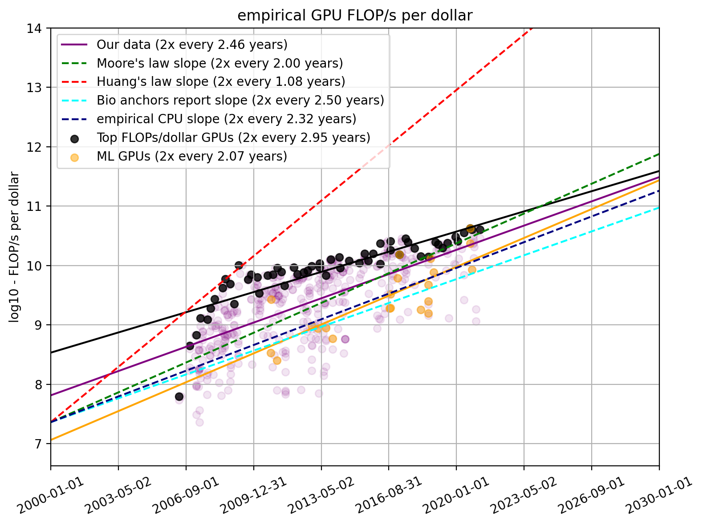
Force 2: Computing Power
Fast processors for deep learning!
Cheaper computing power over time.
The amount of computing power, per dollar
https://www.lesswrong.com/posts/c6KFvQcZggQKZzxr9/trends-in-gpu-price-performance
Notes:
While processors are getting faster, the money cost of computing is coming down.

Slide 41
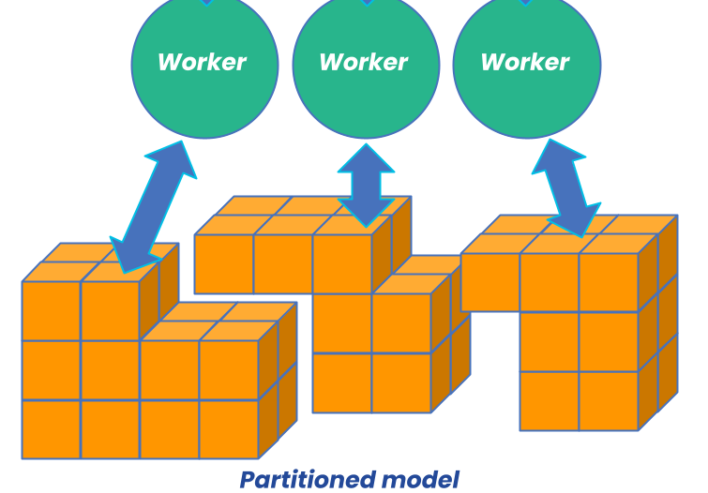
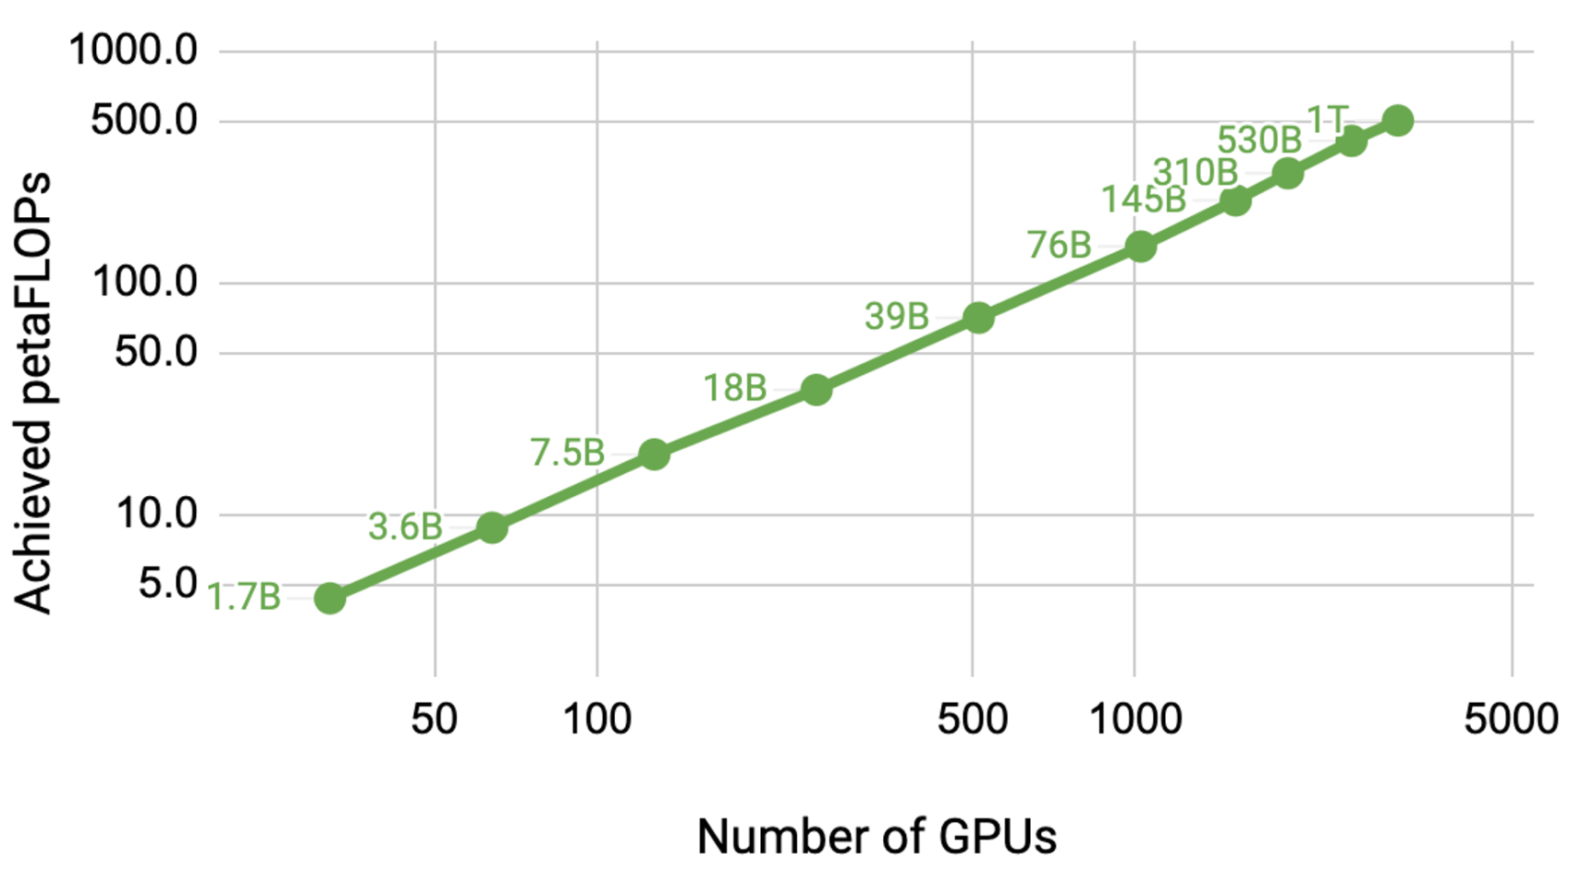
Force 2: Computing Power
Fast processors for deep learning!
Cheaper computing power over time.
Distributed training/inference allows us to scale to a larger set of processors.
Image source: https://developer.nvidia.com/blog/scaling-language-model-training-to-a-trillion-parameters-using-megatron/
Notes:
Moreover, we have learned how to scale up our approach by distributing our computational problems across many processors.
And by doing that, we are able to use much more computational power than what individual GPUs offer

Slide 42
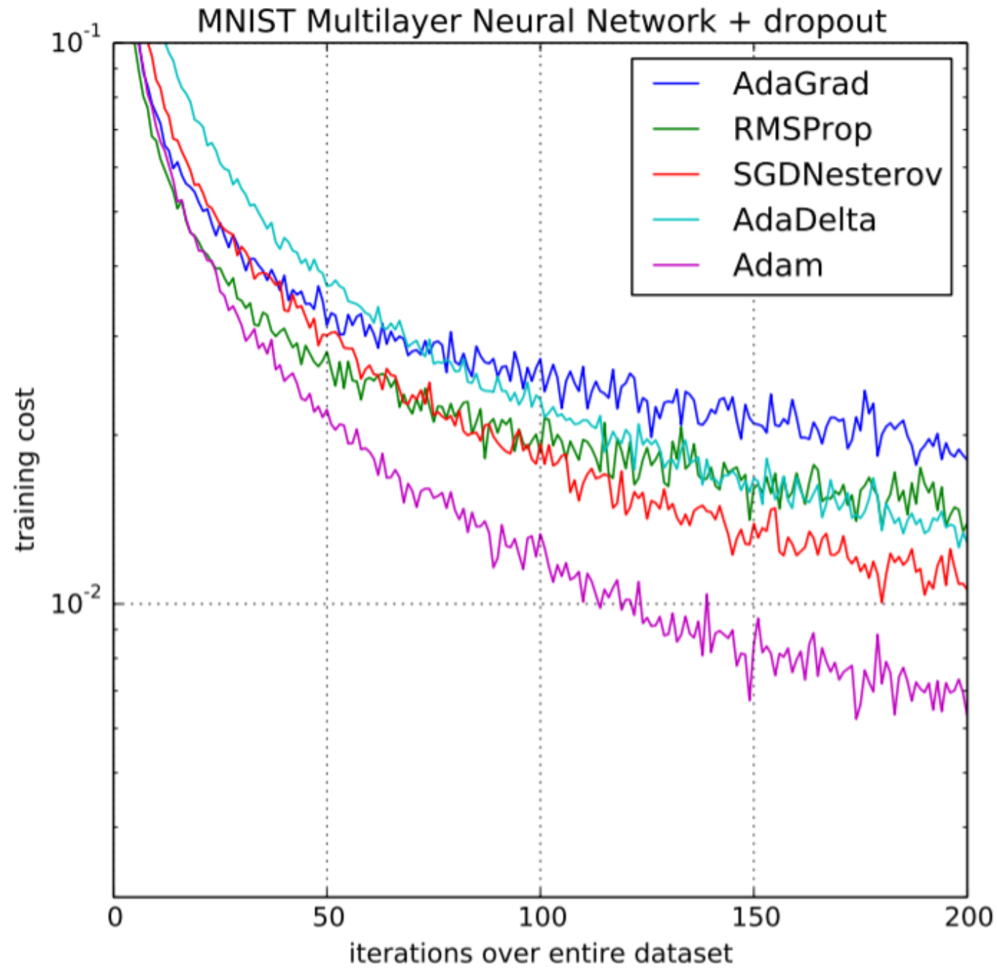
Force 3: Algorithmic innovations
Advances in optimization
Notes:
The last but not the least, is our scientific progress in AI
For instance,
There has been progress in the optimization of large neural networks.

Slide 43
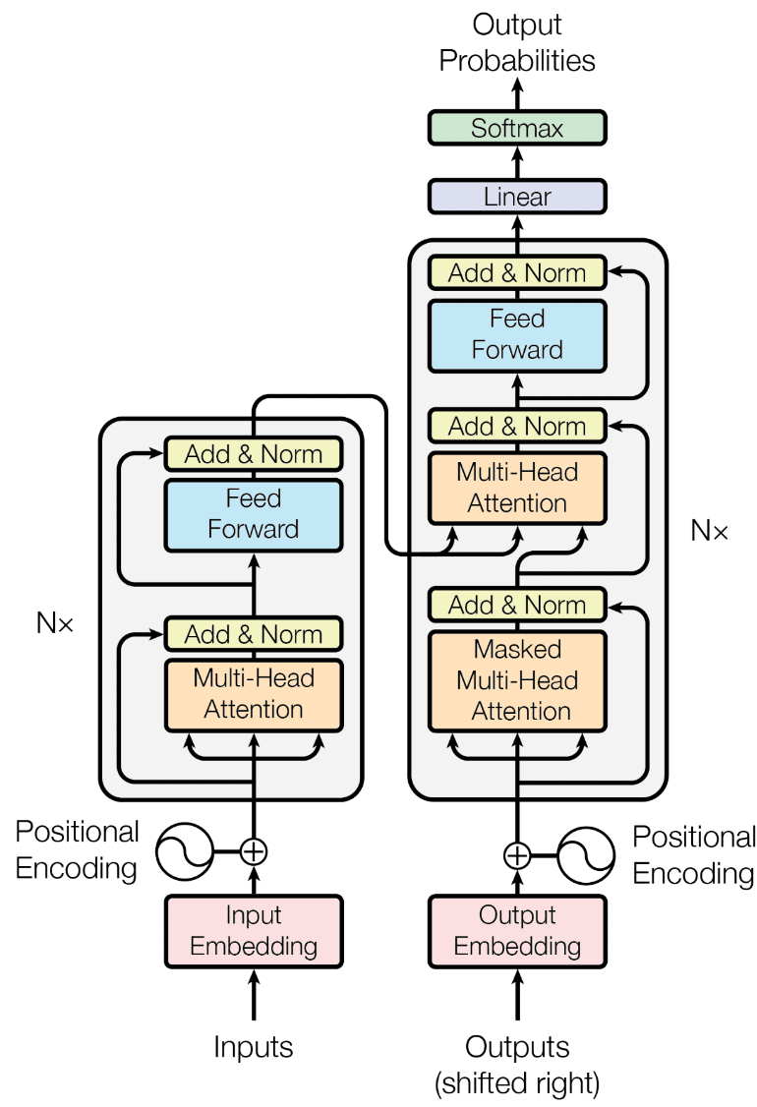
Force 3: Algorithmic innovations
Advances in optimization
Innovations in model architectures
….
Notes:
Or new architectures — at this point you might not know what this picture is, but we will go through these extensively.

Slide 44
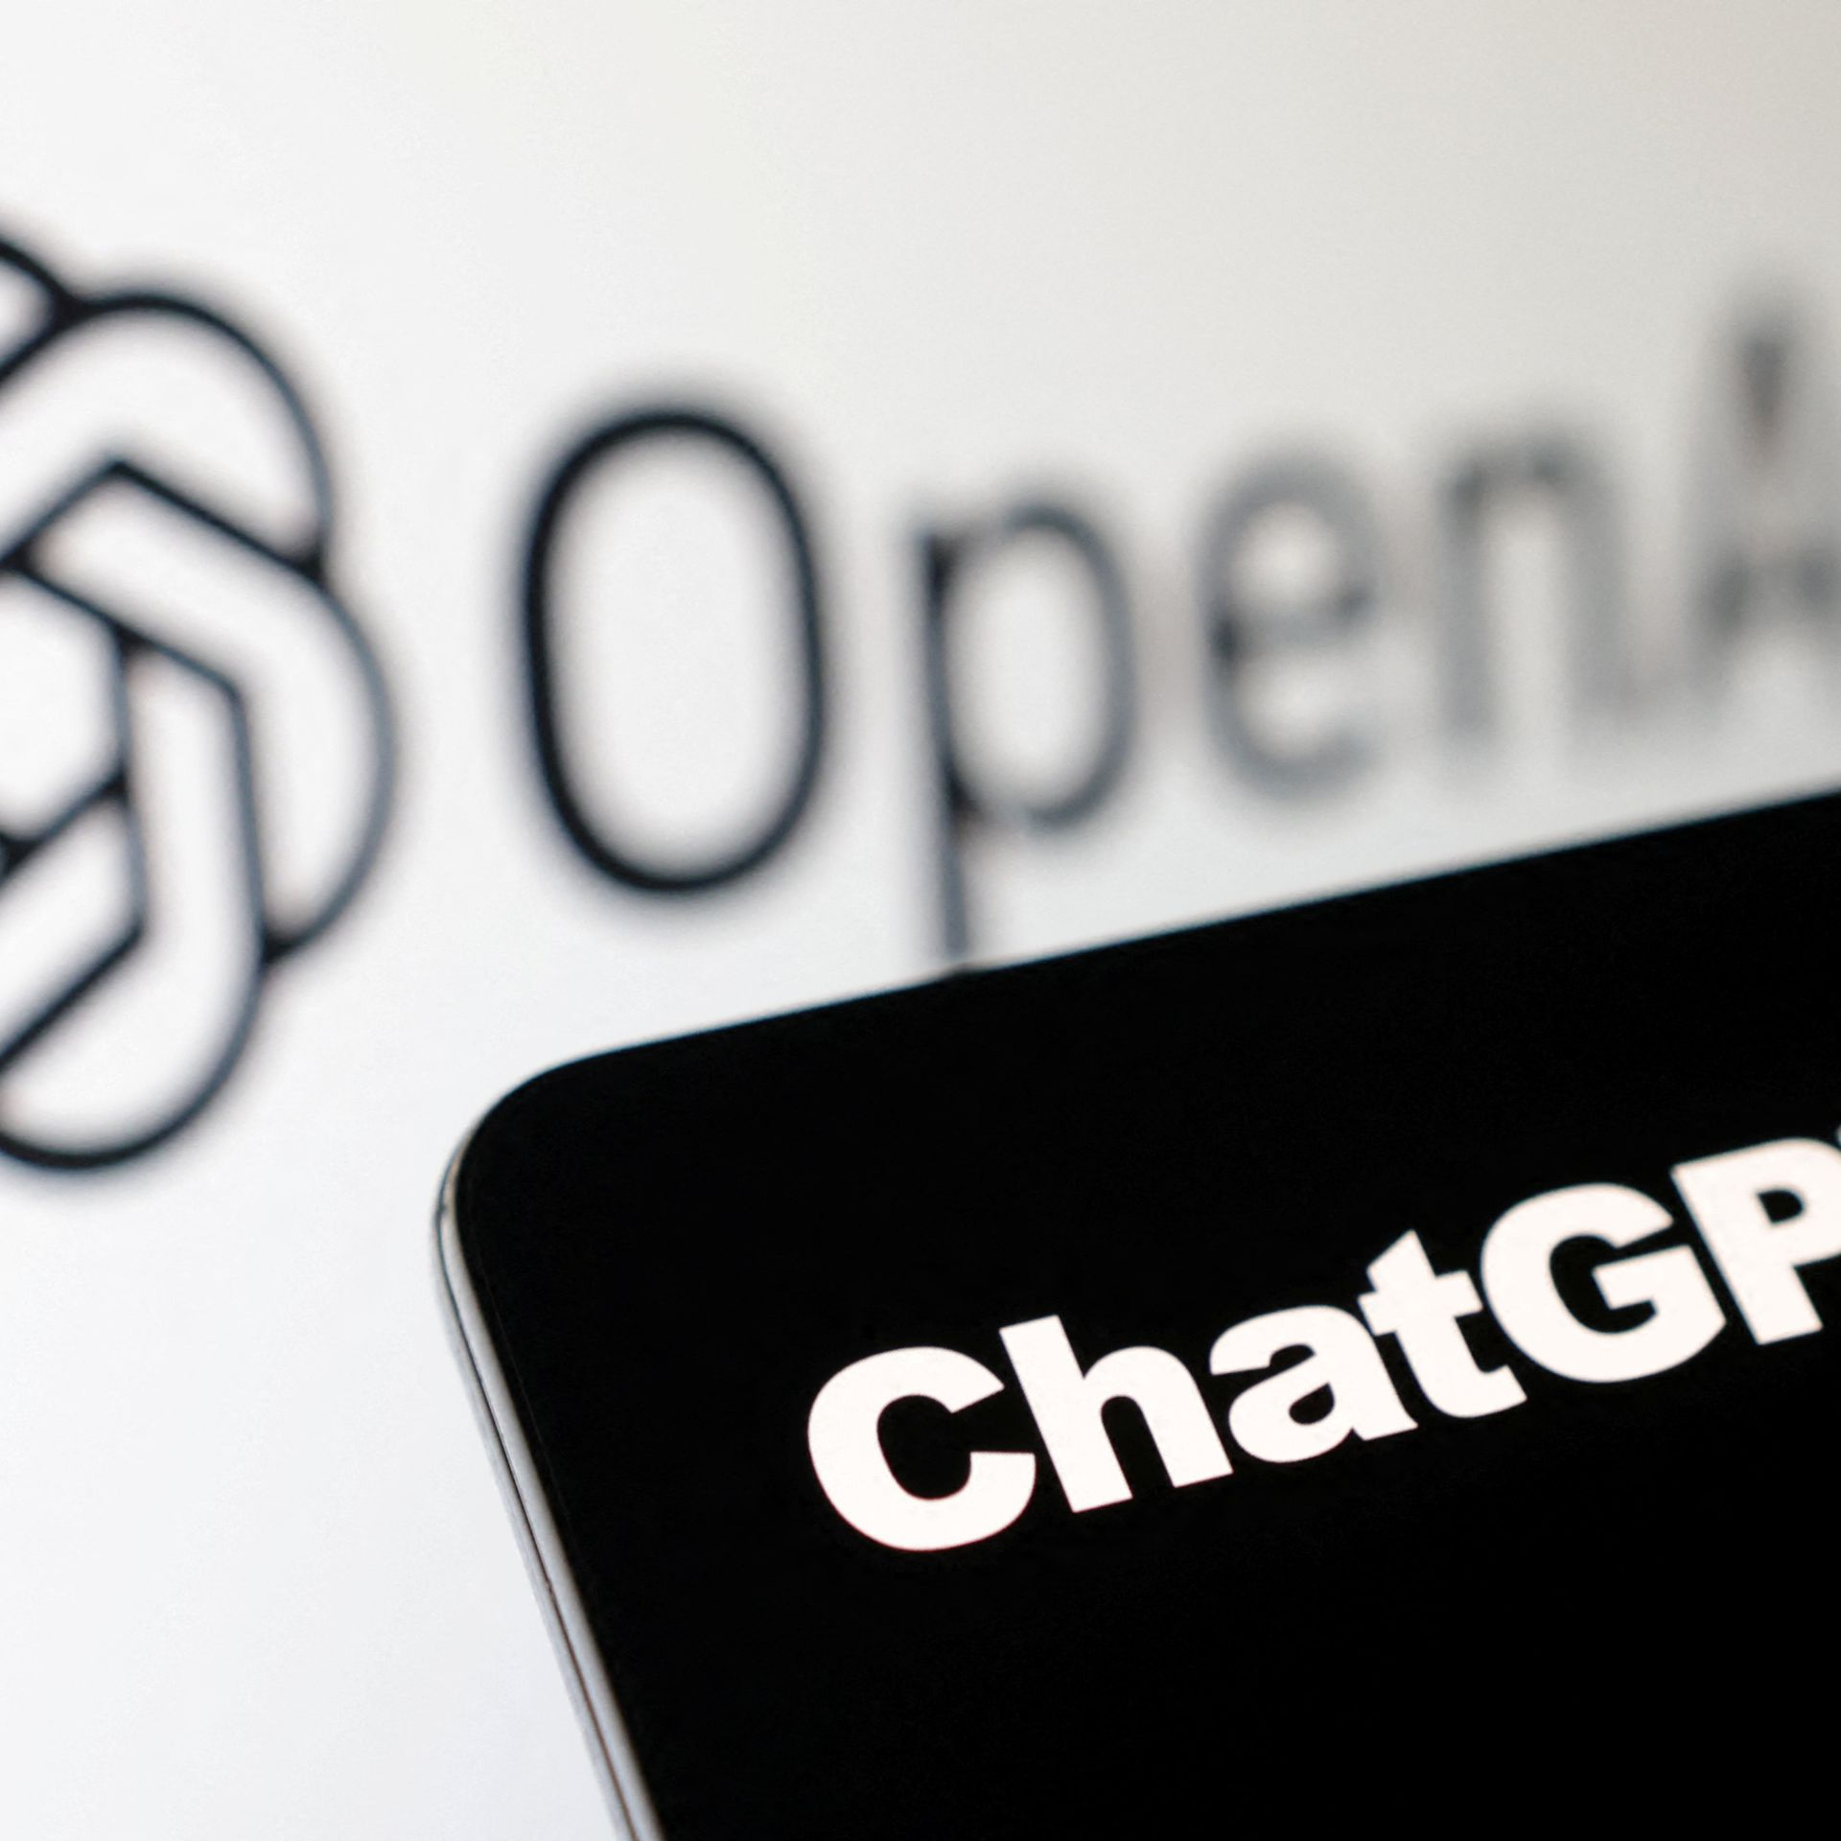




The success we dreamed of
Language models that are remarkably capable at solving many important NLP benchmarks.
Notes:
And putting together all these forces has given us the self-supervised models, that have been the backbone of the recent progress in AI.
So much so that some people got the impression that AI systems are closing in on human intelligence. Well, that’s something that we will debate. There is a lot to talk about on these.

Slide 45
Current state of Self-supervised Models
Almost every AI model is based on Neural networks
Performance is consistently improving with scale
More training data
Larger models (number of neural network parameters)
[Slide credit: Arman Cohan]

Slide 46
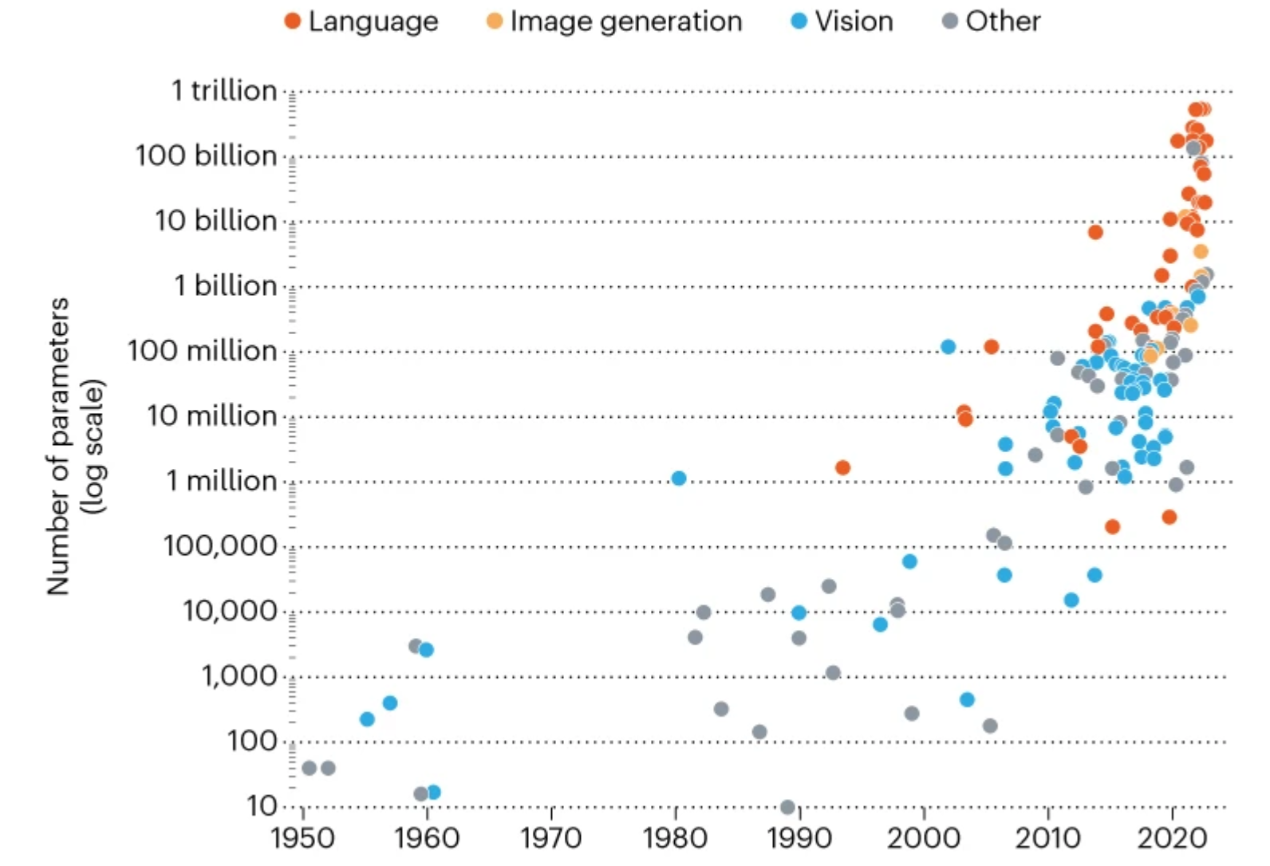
Current state of Self-supervised Models
State-of-the-art models are hundreds of billions of parameters
Image from: In AI, is bigger always better? https://www.nature.com/articles/d41586-023-00641-w
[Slide credit: Arman Cohan]

Slide 47



Current state of Self-supervised Models
PALM
State-of-the-art models are hundreds of billions of parameters
Trained on vast amounts of data (Trillions of tokens)
GPT-3
LLAMA
Image from: In AI, is bigger always better? https://www.nature.com/articles/d41586-023-00641-w
[Slide credit: Arman Cohan]

Slide 48
On terminology
These names are sometimes used interchangeably:
Self-supervised models
Pre-trained models
Generative AI models
Foundation models
Frontier models
…
Though they’re not exactly the same.
Notes:
I also make one clarification in terms of our terminology.
Many people in the field, use slightly different terms to refer to what I call “self-supervised learning”
[read them]
While these terms are quite relevant, they’re not exactly the same.

Slide 49
On terminology
These names are sometimes used interchangeably:
Self-supervised models
Pre-trained models
Generative AI models
Foundation models
Frontier models
…
Though they’re not exactly the same.
Our models are more than just “pretrained”!
Notes:
Pre-trained models: we will talk about this term extensively and you will see how it ties to self-supervised models.

Slide 50
On terminology
These names are sometimes used interchangeably:
Self-supervised models
Pre-trained models
Generative AI models
Foundation models
Frontier models
…
Though they’re not exactly the same.
~ Models that generate content
Notes:
“Generative AI” might be a name that you heard about in the news — it refers to category of AI models that can generate new content including text, images, audio, …
Not all self-supervised models are “generative”.
Not all “generative” models need to be self-supervised
We will see these throughout the course

Slide 51
On terminology
These names are sometimes used interchangeably:
Self-supervised models
Pre-trained models
Generative AI models
Foundation models
Frontier models
…
Though they’re not exactly the same.
~ can be used as a foundational component of modern AI systems
That doesn’t mean that these models are the foundation of AI!
More discussion on naming (Bommasani et al., 2021) https://arxiv.org/pdf/2108.07258.pdf
Notes:
“Foundation models” is an informal label for a large family of models that support a backbone of modern AI systems
The term “Foundation models” Doesn’t mean that these models are foundation of AI!!
This means majority of AI systems build on top of these models
The better foundation you have, the better AI system you will get in the end.
Poorly-constructed foundations are a recipe for weaker products
For now, it happens that all these “foundation models” are developed via supervised learning (synonymous for now)
But things may change in future. For example, self-supervised models might become the thing itself, as opposed playing a supportive role.

Slide 52
On terminology
These names are sometimes used interchangeably:
Self-supervised models
Pre-trained models
Generative AI models
Foundation models
Frontier models
…
Though they’re not exactly the same.
They’re user-facing “frontiers” of applications

Slide 53
On terminology
These names are sometimes used interchangeably:
Self-supervised models
Pre-trained models
Generative AI models
Foundation models
Frontier models
…
Though they’re not exactly the same.

Slide 54
On terminology
These names are sometimes used interchangeably:
Self-supervised models
Pre-trained models
Generative AI models
Foundation models
Frontier models
…
Which is your favorite? 😊
Notes:
Which name is your favorite?
I am not going to pick any favorites now — but I am sure you can infer that based on the name of this course!

Slide 55
ML
Deep learning
Self-supervised models
Generative AI
LLMs
[Slide credit: Arman Cohan]

Slide 56
Course Learning Objectives
We will cover a variety of inter-related topics:
Architectures
Pre-training
Alignment and safety
Efficiency
Interaction with the world (code, physical world, etc.)
Impacts on humans -- their misuse, biases, etc.
Skills:
Technical—understanding of the algorithms and implementing them.
Gaining intuitions about capabilities and limitations of models.
Soft skills—algorithms, PyTorch, SLURM, intuition about capabilities, teamwork.

Slide 57
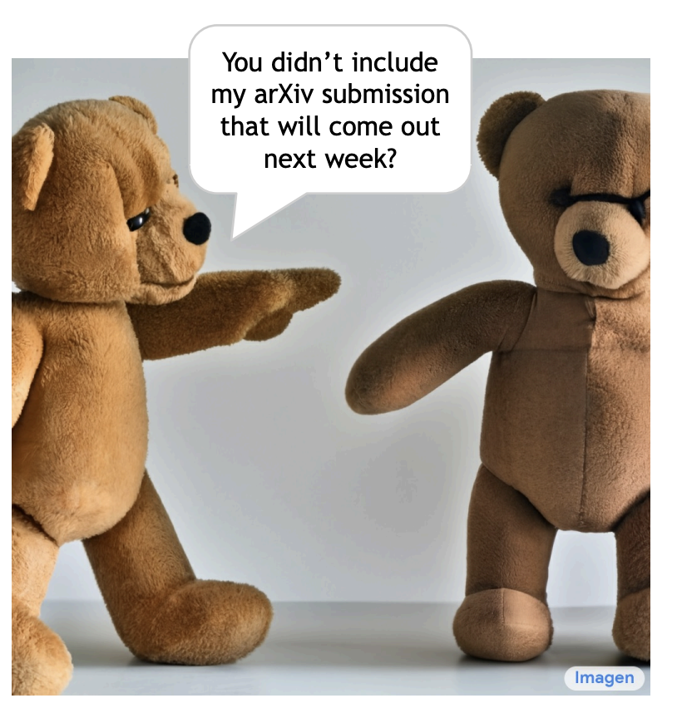
Disclaimer
We will not be exhaustive.
The goal is to give you a bird’s-eye view of the field.
Notes:
We are going to cover a lot of grounds, but we will not be exhaustive.
The goal is to …
We will stop here.

Slide 58
Course Logistics
CSCI 601-471/671 (NLP: Self-Supervised Models)
https://self-supervised.cs.jhu.edu/sp2024/

Slide 59
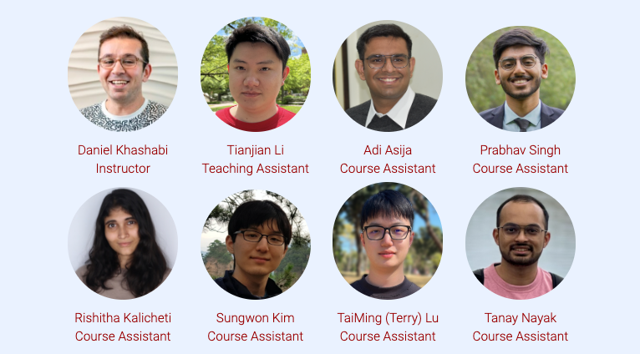
Course Logistics Brief
Instructor: Daniel Khashabi
I prefer just “Daniel”, as long as we act mutually respectfully.
No "prof Daniel"!! 🙅
TA: Tianjian Li
CAs: Sungwon, Tanay, Adi, TaiMing, Prabhav, Rishitha

Slide 60
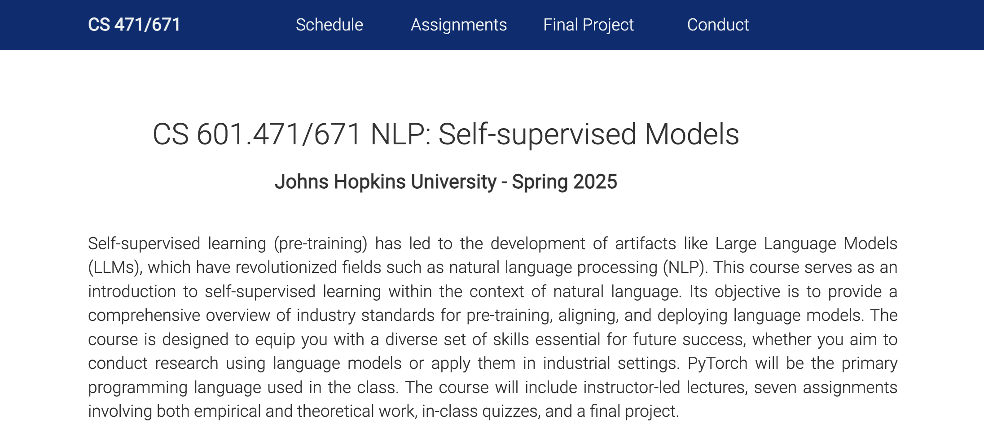
Course Website
Lots of important information on the website:
https://self-supervised.cs.jhu.edu/sp2025
Notes:
Now that we have defined what ”self-supervised models” let’s what’s in this class.

Slide 61


Other Relevant Websites
Notes:
Now that we have defined what ”self-supervised models” let’s what’s in this class.

Slide 62
Course Prerequisites
Comfortable with programming, particularly Python
Calculus, linear algebra, probability
Familiarity with Natural Language Processing
HW1 should give a sense how prepared you are!

Slide 63
Quick pulse check
Do I understand how “gradient descent” works?
Yes
No

Slide 64
Course Logistics Brief
Pre-recorded videos: will be available on the course website and/or Piazza.
Office hours: regular office hours; will be announced on Piazza.
Questions or discussions: Piazza

Slide 65
Course Work and Grading Policy
Homework (team optional): 40%
7 x 1-week assignments
3xMidterm quizzes (individually): 40%
Final course project (team optional): 20%
Bonus points:
Extra credit questions (HW and quizzes): +10%

Slide 66
Homework
Timeline:
Released every Tuesday and due in a week.
Each have both conceptual (theory) and empirical (coding) parts.
All assignments will be submitted to Gradescope.
Late day policy
7 free late days across all assignments; afterwards, 5% off course grade per day late
Assignments not accepted more than 7 days late (unless given permission in advance)
Collaboration policy: Allowed within certain limits:
Needs to be well-documented; acknowledge working with other students.
Avoid: copying code off the web or ChatGPT! — write your own solutions.

Slide 67
HW1 is released!
Due Tuesday.
Has both theory (background on algebra, etc.) and programming (building a classifier).
A baseline for self-assessment.
Future homework will be more advanced.

Slide 68
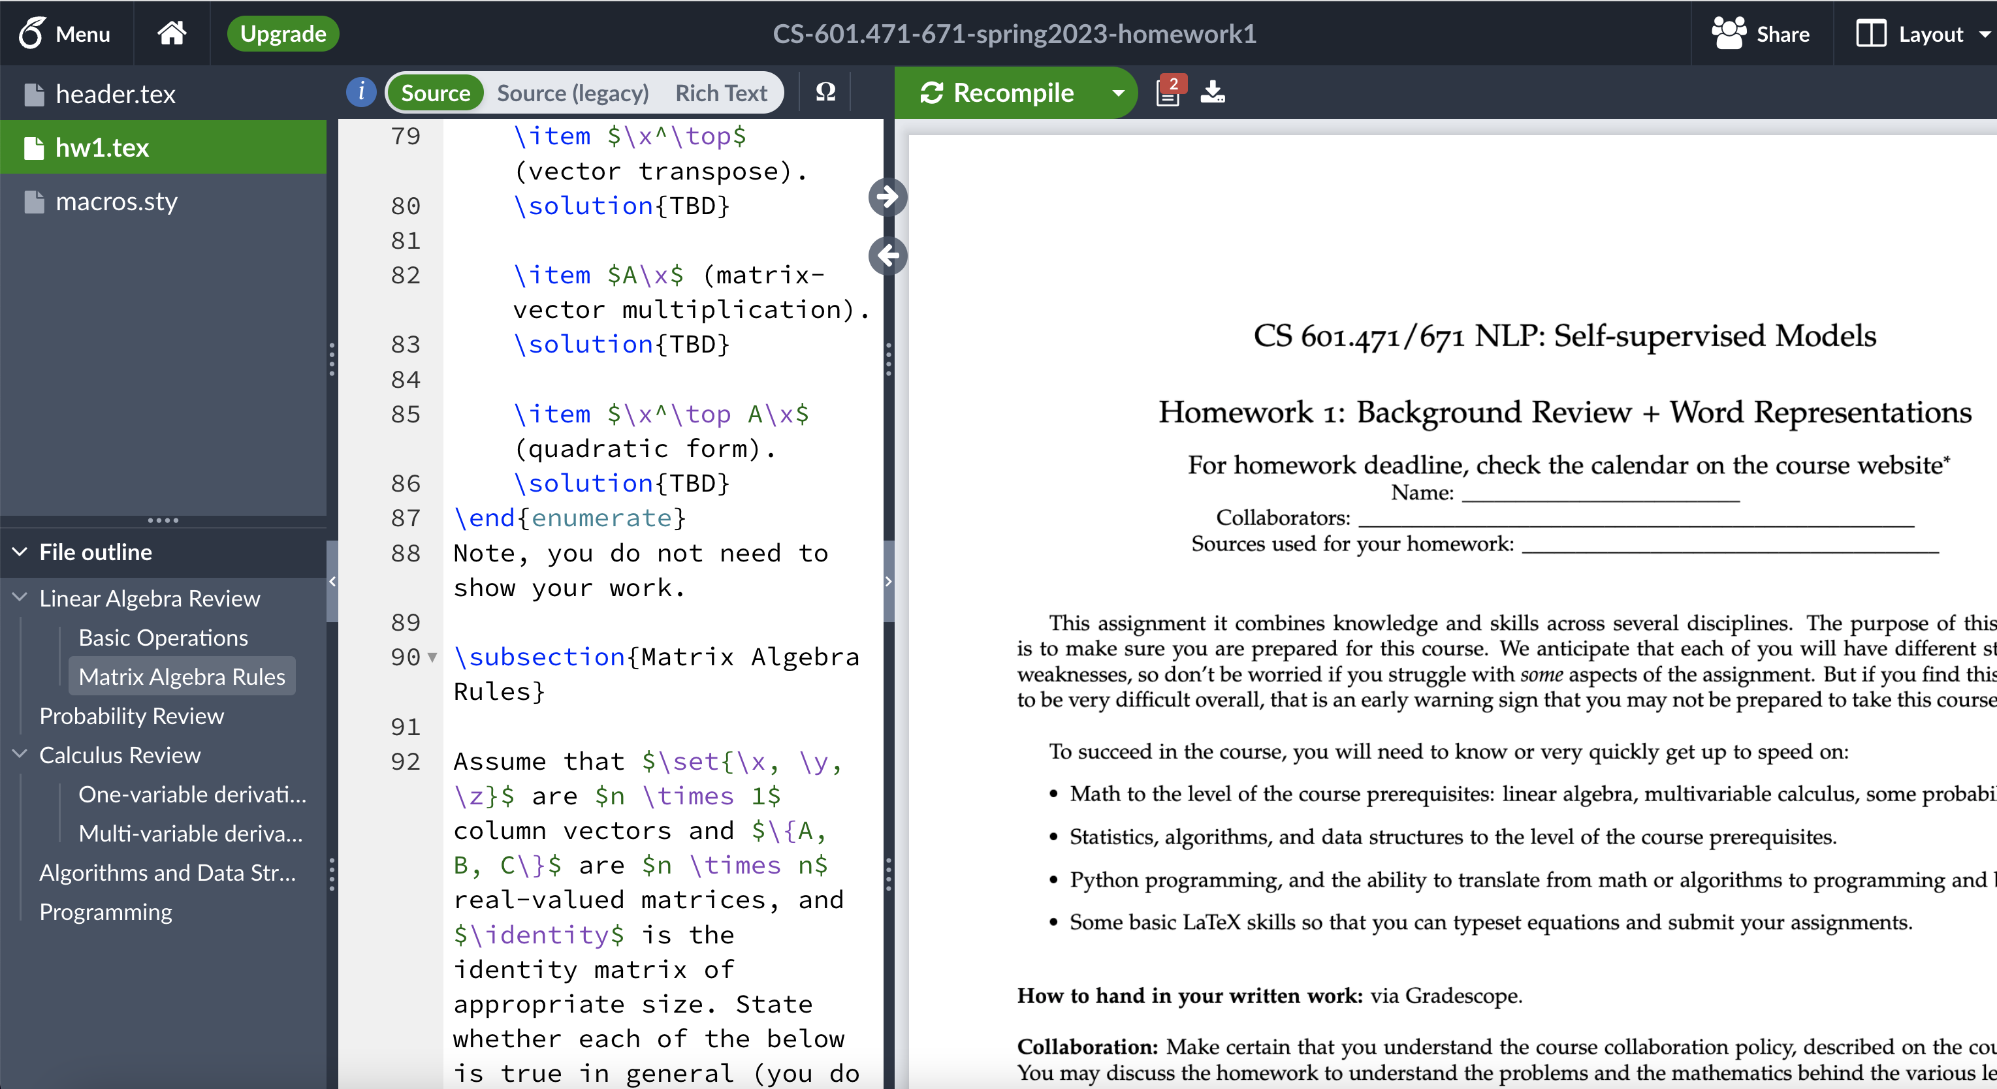
“Is Typesetting Mandatory?”
No, but …
But 10x strongly recommended.
It is a must-have skill if you’re considering going to any research field.

Slide 69
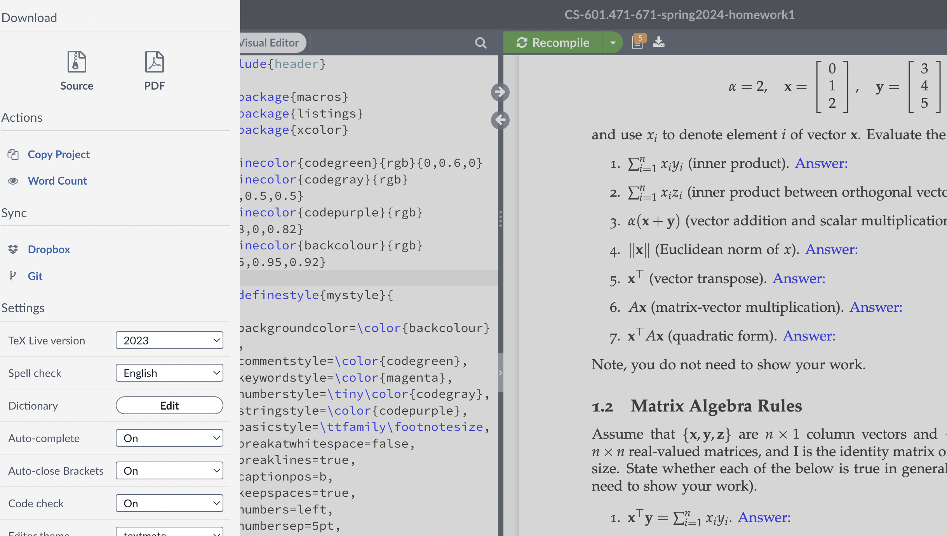
How do I edit the overleaf file?
Open the link; click on “Menu”; click on ”Copy Project” to clone it.

Slide 70
Final Project
No HW after spring break to let you focus on your final project.
Topic:
Default projects: we will give you well-defined, scoped projects.
Custom projects: can bring your own idea, as long as it is related to the class.
This is your chance to hone your technical skills on a topic of interest.
Deliverables:
Submit project proposal outline (for our formal review and suggestions)
To make sure the proposals are well scoped and doable in limited time.
Get excited 🤩 and work on the project
Midway report
Final project poster session and report

Slide 71
Attendance Policy
Not mandatory!
Notes:
Students who report symptoms associated with COVID-19 are expected not to attend class

Slide 72
Attendance Policy
Not mandatory!
No additional grade if you attend.
However, it is highly encouraged!!
Participation in class is our chance to learn more effectively.
Come to the class and participate in the discussions!
Notes:
Students who report symptoms associated with COVID-19 are expected not to attend class

Slide 73
Quick pulse check (1)
I am a ….:
CS major,
CS minor,
MS student,
PhD student,
None of the above??

Slide 74
Quick pulse check (2)
Which one best describes you?
NLP and DL are rather new to me. Looking forward to learning more.
I am a DL, NLP or self-supervised learning enthusiast – I read casually on these topics.
I am practitioner of NLP or ML and have already worked with a variety of self-supervised models.
I am a pro. I could be part of the teaching staff of this class.

Slide 75
Quick pulse check (3)
I have read (and understood) the syllabus!
Yes
No

Slide 76
Wrapping it up!
HW1 is released!
If you’re not going to take this, drop the course!
Many are on the waitlist for the 671 session (not 471).

